Slide 1


AQI TRACKER
Team Members:2320030070 - Dharani2320030072 - Mahati2320030384 - Mallika

Slide 2

Introduction: Why Real-Time Air Quality Matters
Air pollution is a pressing environmental concern, particularly in urban centers, significantly impacting public health and overall quality of life. Our project, the AQI Tracker, directly addresses this challenge by providing a robust system for real-time air quality monitoring.
Proactive Response
Data-Driven Insights
Hazard Detection
Enables immediate action during pollution spikes, protecting citizens.
Leverages publicly available datasets to simulate continuous sensor feeds.
Processes and analyzes real-time data to rapidly identify hazardous pollution events.
By doing so, the AQI Tracker aims to empower both individuals and authorities with the information needed to make informed decisions for environmental management.

Slide 3

The Data Engineering Pipeline: From Sensor to Insight
Our AQI Tracker is built upon a sophisticated data engineering pipeline designed for efficiency and accuracy. This pipeline is crucial for transforming raw sensor data into actionable environmental intelligence.
01
02
03
Data Ingestion
Data Cleaning & Preprocessing
Data Storage
Continuously captures air quality data streams from public APIs or simulated sensor feeds. We utilize tools like Apache Kafka for high-throughput data streaming.
Crucial for data integrity, this step involves handling missing values, filtering noise, and normalizing pollutant readings and timestamps. Apache Spark and Pandas are employed here.
Stores both real-time and historical sensor data in optimized databases for rapid querying and analysis. Technologies like InfluxDB or TimescaleDB are ideal for this time-series data.

Slide 4
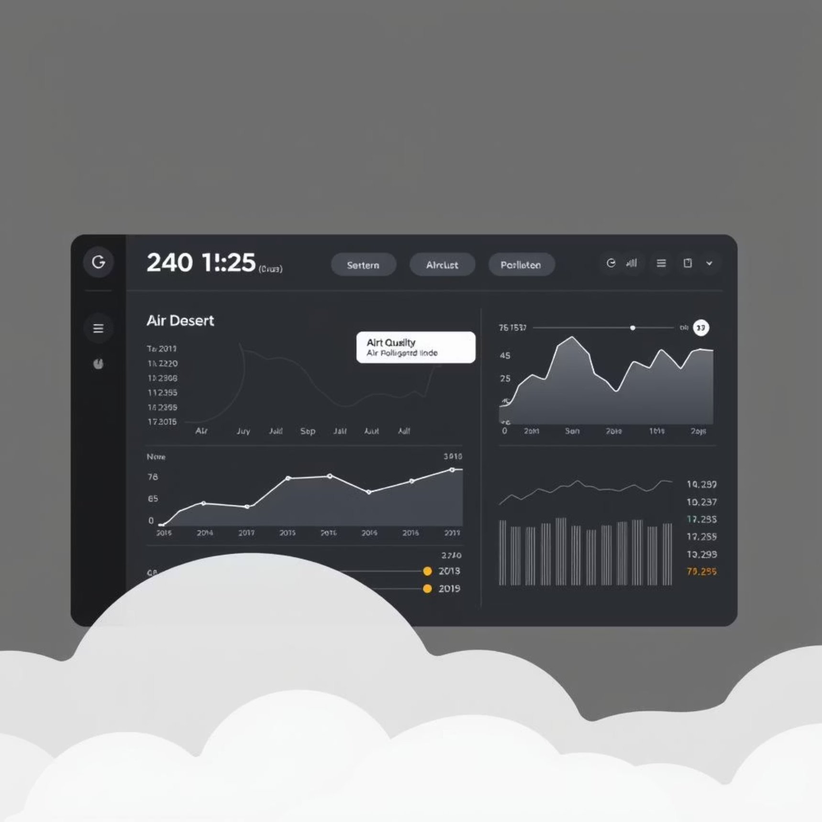

Real-Time Analytics & User Empowerment
Beyond just collecting and storing data, the AQI Tracker excels in real-time analysis and delivering immediate value to its users.
Spike Detection & Alerts
Leveraging Apache Flink and Spark Streaming, our system continuously monitors incoming data for pollution spikes or anomalies. When predefined thresholds are exceeded, immediate alerts are triggered.
Visualization & Dashboards
Live, interactive dashboards are created using tools like Grafana or Kibana, providing a clear visual representation of current and historical air quality.
These dashboards are critical for environmental agencies and the public to quickly understand the air quality situation.

Slide 5

Impact and Future Outlook
The AQI Tracker project is designed to foster a more informed and proactive approach to environmental health in urban environments.
Timely Alerts
Enhanced Public Awareness
Data-Driven Environmental Management
Notifications via AWS SNS or Twilio inform citizens and authorities when pollution levels exceed safe limits, enabling them to take protective actions.
By making complex air quality data accessible and understandable, the project empowers communities to advocate for cleaner air.
Provides environmental agencies with the tools to monitor, analyze, and manage air quality more effectively, leading to better policy decisions.
Our commitment is to evolve this system, integrating more data sources and predictive analytics to anticipate air quality changes and further safeguard public health.

Slide 6





Methodology
Our approach to developing the AQI Tracker is rooted in established data engineering principles and a thorough review of existing environmental monitoring solutions. This ensures a robust, scalable, and accurate system.
Systematic Review
Data Sourcing Strategy
A comprehensive literature review on real-time air quality monitoring systems informed our design, focusing on data sources, processing techniques, and alert mechanisms.
We prioritized public APIs for real-world data and developed synthetic sensor data generation for robust testing and comprehensive scenario coverage.
Architectural Design
Validation & Benchmarking
A modular, cloud-native architecture was developed to ensure high availability, fault tolerance, and scalability across all data pipeline stages.
Rigorous validation compared real-time output against historical pollution event data and industry benchmarks to confirm accuracy and reliability.

Slide 7




Literature Review: Foundations and Insights
Our comprehensive literature review provided the intellectual groundwork for the AQI Tracker, ensuring our design leveraged established best practices and addressed common challenges in environmental data engineering.
Data Generation & Ingestion Strategy
Real-time Processing Architectures
Alerting & Visualization Mechanisms
Explored various air quality datasets and standardized AQI models to simulate real-time sensor behavior using CSV-based inputs, shaping our data ingestion and preprocessing workflow..
Investigated stream processing frameworks, validating our choice of Apache Kafka and Spark for high-throughput analysis.
Studied effective ways to communicate real-time pollution data and trigger timely alerts, guiding our dashboard and notification features.
This research informed our technology stack choices and architectural decisions, ensuring the AQI Tracker is both innovative and robust.

Slide 8







Outcome Summary: Realizing the Vision
The AQI Tracker project delivers a robust solution with several key outcomes, transforming raw data into actionable environmental intelligence and empowering users with critical insights.
Dynamic City Input
Live Data Analysis
Flexibly monitor air quality for any specified city, adapting to diverse geographical needs.
Fetches and analyzes air quality data streams in real-time, providing immediate insights.
Processed AQI Report
Interactive Dashboard
Generates a comprehensive CSV output with computed AQI values for easy review and record-keeping.
Utilizes a Streamlit dashboard for intuitive visualization of pollution trends and alerts.
Automated Spike Detection
Scalable & Integrated
Automatically identifies and flags pollution spikes, triggering timely alerts for critical events.
Designed for scalability, ready for seamless integration with IoT devices or advanced ML models.

Slide 9







Who Benefits Most?
The AQI Tracker provides invaluable insights for diverse stakeholders, empowering them to make informed decisions for healthier urban living and effective environmental management.
Empowered Citizens
Regulatory Oversight
Individuals receive timely alerts and clear data, enabling proactive decisions about outdoor activities and personal health, especially for sensitive groups.
Environmental agencies gain real-time monitoring capabilities, supporting effective policy implementation and pollution control strategies.
Strategic Urban Planning
Proactive Healthcare
City planners leverage data to design healthier cities, optimize infrastructure, and implement green initiatives that reduce air pollution hotspots.
Healthcare professionals can better advise patients on pollution risks and track environmental factors influencing respiratory and cardiovascular health.
Agricultural Stakeholders
Educational Institutions & Researchers
Farmers and agricultural professionals can protect crops from pollution damage, optimize planting schedules based on air quality, and better understand environmental factors affecting crop yields and livestock health.
Schools, universities, and research institutions can protect students during outdoor activities, conduct environmental research, make informed decisions about campus operations, and utilize real-time data for academic studies and public health research.

Slide 10




Conclusion: A Vision Realized
The AQI Tracker project culminates in a powerful, real-time air quality monitoring system that transcends theoretical concepts to deliver tangible benefits, paving the way for healthier communities and smarter environmental stewardship.
Improved Public Health
Data-Driven Governance
Scalable Innovation Platform
By providing immediate, accurate air quality data and alerts, the system directly contributes to better public health decisions, especially for vulnerable populations.
Environmental agencies and urban planners are now equipped with actionable insights to craft more effective policies and implement targeted interventions for pollution control.
The robust architecture offers a seamless pathway for integration with advanced IoT devices, predictive analytics, and future machine learning models, ensuring continuous evolution.
This project stands as a testament to the power of data engineering in addressing critical environmental challenges, fostering a future where clean air is a accessible reality for all.

Slide 11


Thank You!
We appreciate your time and attention. We hope this presentation has provided valuable insights into the AQI Tracker project and its potential to foster healthier communities.

